Slide 1
Introduction to Graphics Programming and its Applications
繪圖程式設計與應用
Quiz 2 Buffer & Uniform Answer
Instructor: Hung-Kuo Chu
Department of Computer Science
National Tsing Hua University
CS4505

Slide 2
Objective
Generate a VAO and VBO, then pass the data to GPU
Set a uniform int flag to trigger filter
Sending a draw command

Slide 3
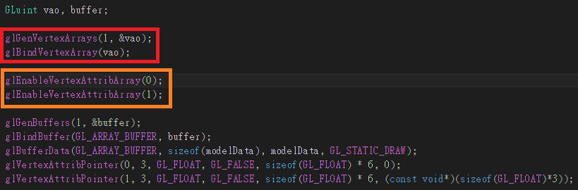
Solution
In main.cpp, function My_init() :
Generate a VAO first then bind it
Enable Vertex attribute array in shader

Slide 4
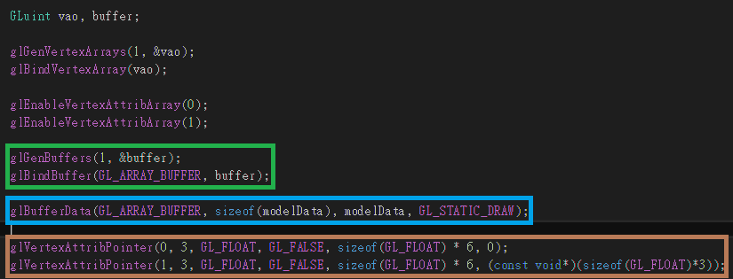
Solution
In main.cpp, function My_init() :
Generate a VBO and then bind it
Pass the modelData to the VBO
Tell GPU how to recognize the buffer data

Slide 5
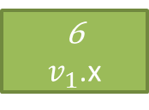
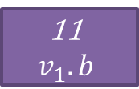
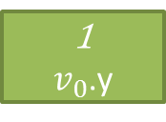
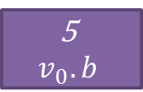
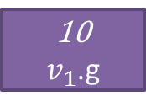
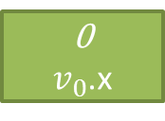
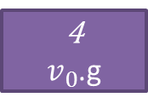
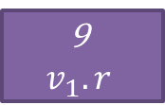
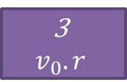
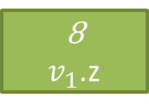
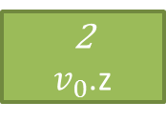
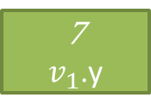
Solution ( Key point )
The format of modelData looks like below
So we have to read each vertex coordinate data(vec3) on starting index 0, 6, 12, …
Read each vertex color data(vec3) in starting index 3, 9, 15, …
0
$v_{0}$.x
1
$v_{0}$.y
2
$v_{0}$.z
3
$$v_{0}.r$$
4
$v_{0}$.g
5
$$v_{0}.b$$
6
$v_{1}$.x
7
$v_{1}$.y
8
$v_{1}$.z
9
$$v_{1}.r$$
10
$v_{1}$.g
11
$$v_{1}.b$$

Slide 6
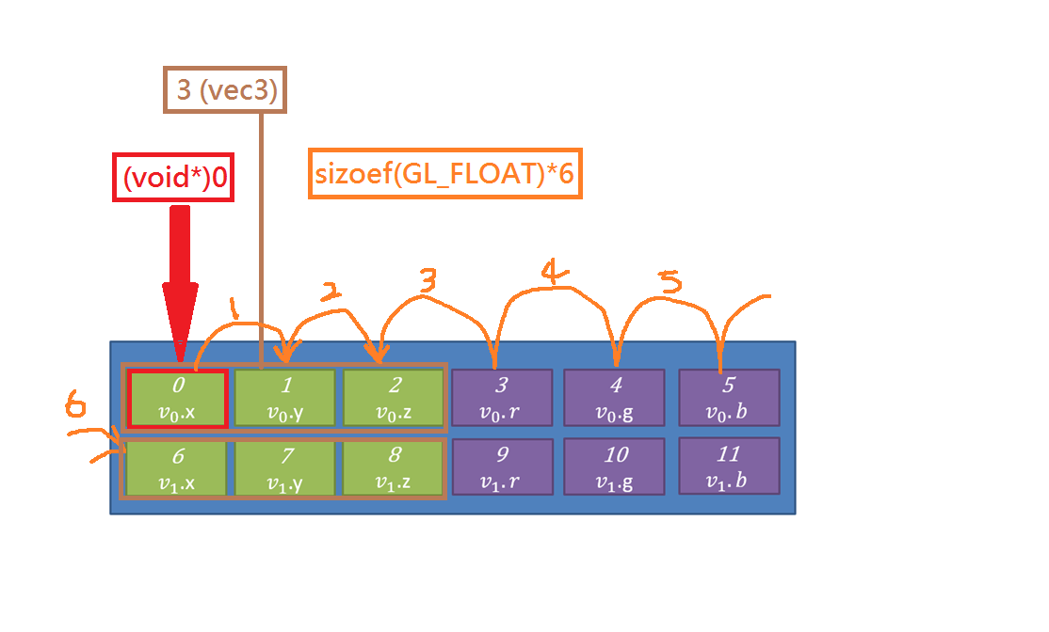
Solution ( Key point )
glVertexAttribPointer(0, 3, GL_FLOAT, GL_FALSE, sizeof(GL_FLOAT)*6, (void*)0);
We will specify the vertex shader (layout location=0) variable to recognize the buffer data
3 means type ‘vec3 ‘ in shader, it also means that we will read 3 GL_FLOAT data continuously
We will recognize those data in buffer as GL_FLOAT
GL_FALSE means not to normalize ( normalized will make vec3(this example) range from 0~255, or it will be range from 0~1 )
This parameter represent stride, which specify where do we could find the next vertex data.
This parameter represent where (starting index) to start to recognize the buffer data

Slide 7
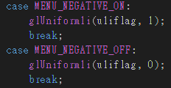
Solution
Set a uniform int flag and trigger it whit menu
In main.cpp, function My_init()
In main.cpp, function My_Menu(int id)

Slide 8
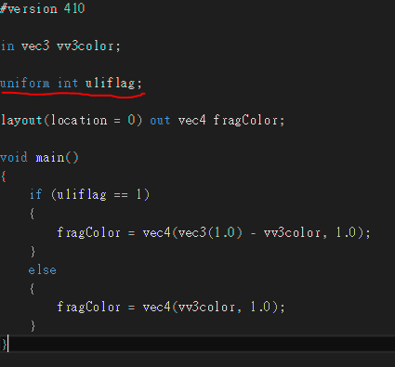
Solution
In fragment shader

Slide 9
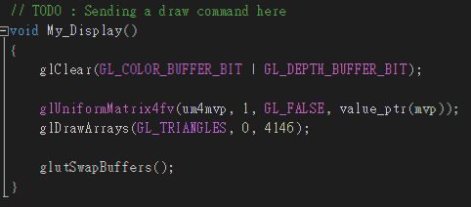
Solution
Sending a drawing command
In main.cpp, function My_Display()
4146 = 1382(#triangles) * 3 = #vertex

